Slide 1
Plant disease recognition dataset

Slide 2
Dr. Raihan Ul Islam
Associate Professor Department of Computer Science & Engineering
Rafia Noor Nithin
01
2022-2-60-120
Fahimah Karim Oishi
02
2022-2-60-134
Bushra Hoque
03
2022-1-60-154
Md. Omor Faruq
04
2022-1-60-335

Slide 3
Objective
Automate accurate plant disease detection.
Evaluate accuracy, efficiency, and generalizability.
Objective
Compare Custom CNN, Hybrid ML classifiers, and Pretrained models.
Identify best-performing architecture.
This template has been created by Slidesgo

Slide 4
Dtasate Details
Dataset
Size
PlantVillage (38 crop-disease categories)
~54K images
Balanced Dataset
Split
350 images per class (used in some models).
70% train, 20% validation, 10% test

Slide 5
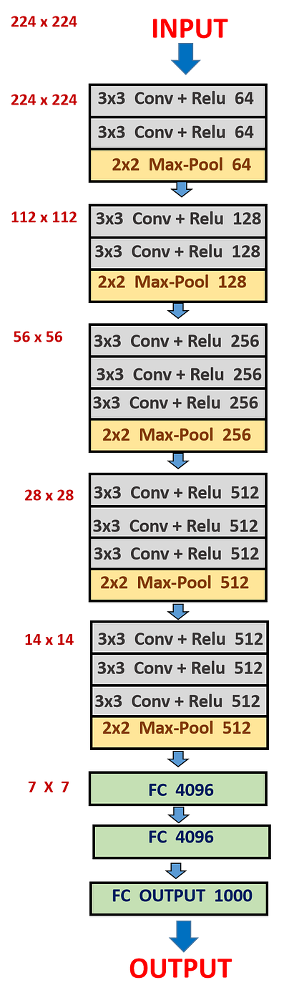
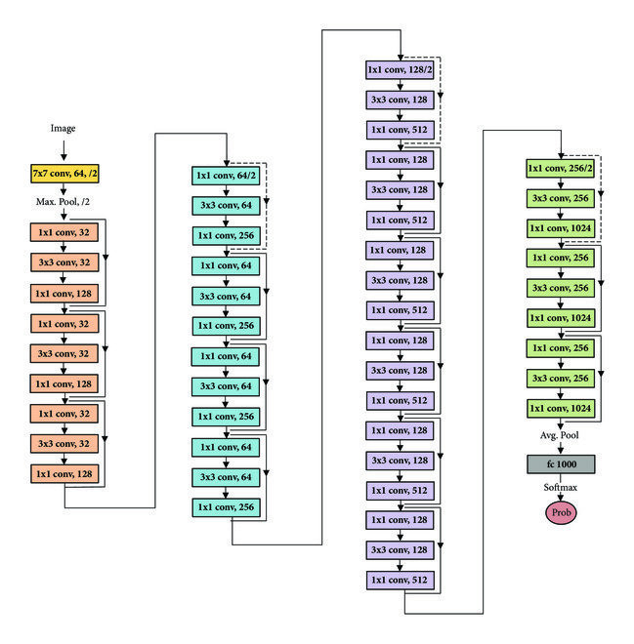
Model Architecture
Resnet50
Vgg16

Slide 6
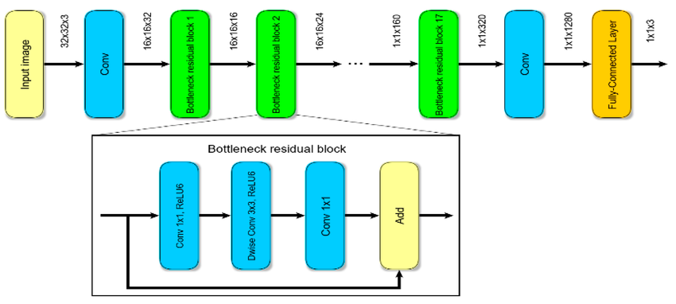
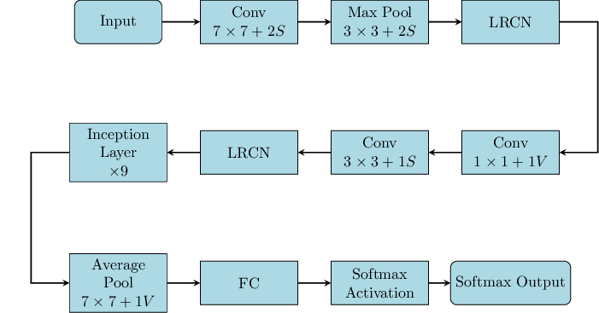
Model Architecture
GoogleNet
MobileNet

Slide 7
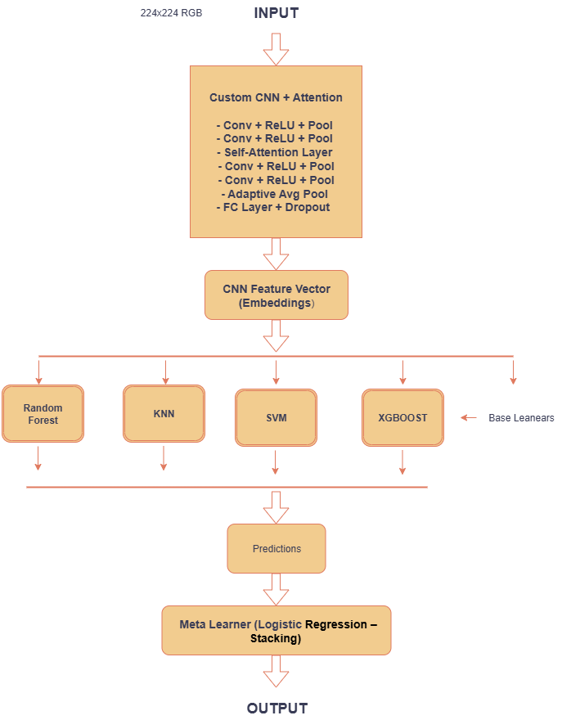
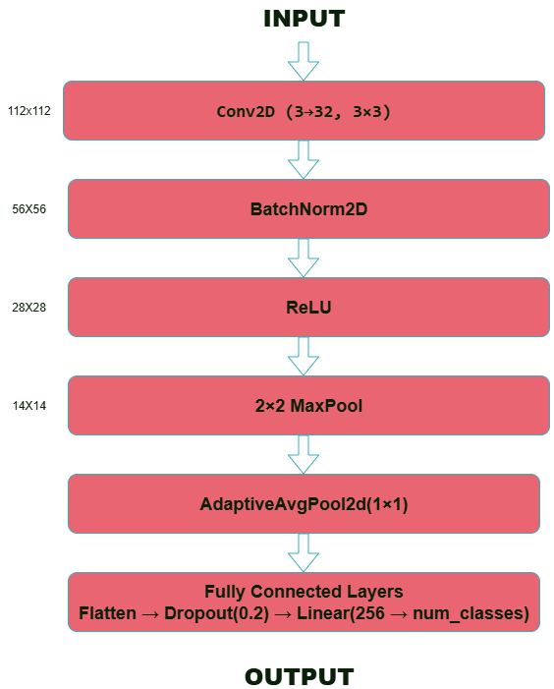
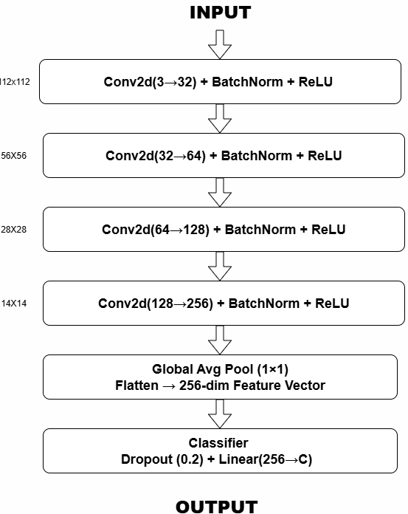
Model Architechtures
Hybrid Model
Custom CNN
CNN With
Ensemble Stacking

Slide 8
Machine Learning Parameters
01
Image size: 224×224
04
Batch size: 32.
02
Optimizer: Adam (lr ~1e-4 to 1e-3).
05
Epochs: ~50 with EarlyStopping.
03
06
Mixed Precision: Used for efficiency.
Loss: CrossEntropyLoss.

Slide 9
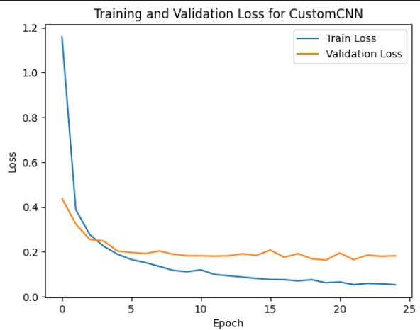
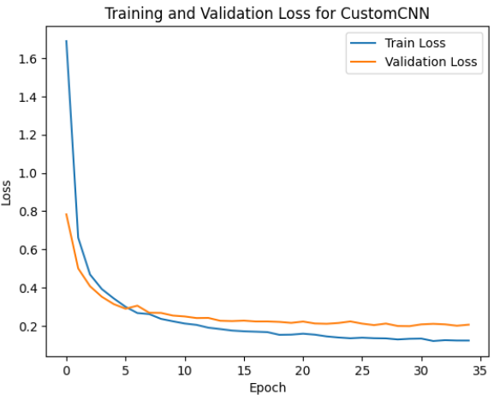
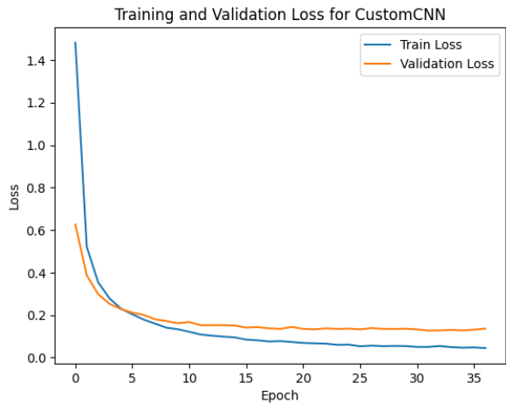
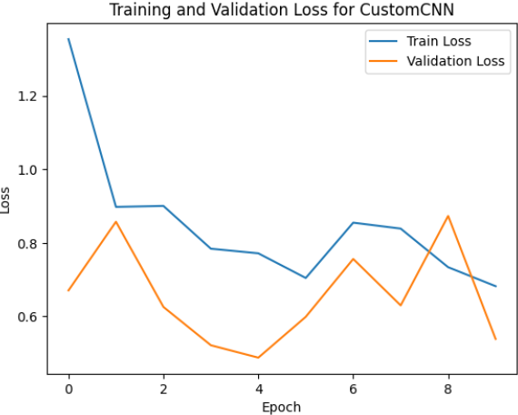
Pre-trained Model Learning Curves
MobileNet
Vgg16
Resnet50
GoogleNet

Slide 10
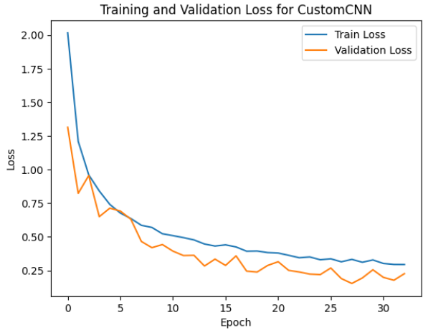
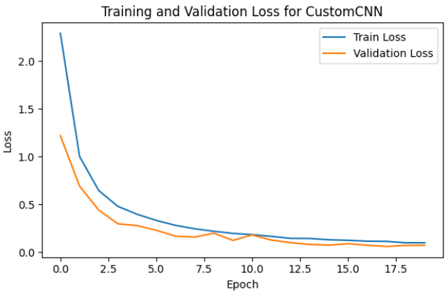
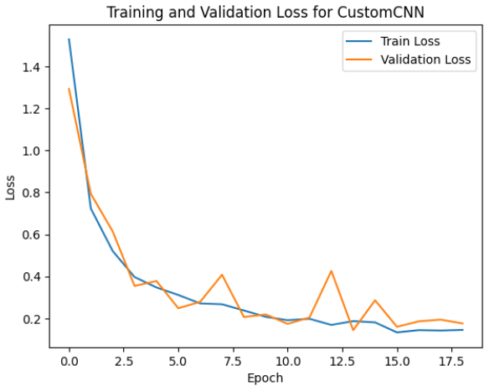
Model Learning Curves
Custom CNN
CNN With
Ensemble Stacking
Hybrid Model

Slide 11
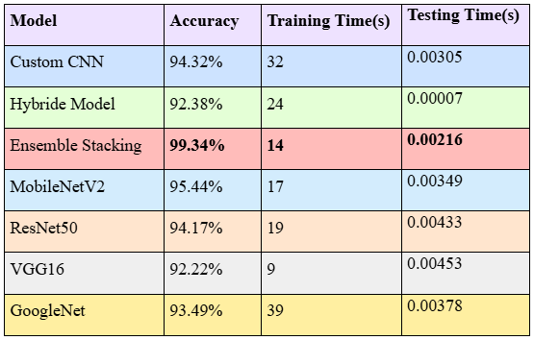
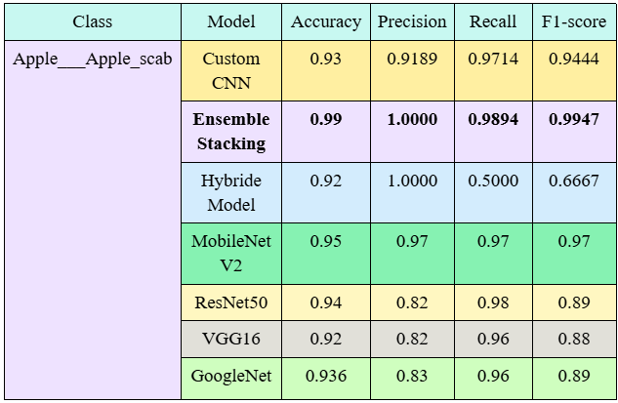
Performance Comparison
01
02
Table-01
Table-02
https://drive.google.com/drive/folders/1iQj_u1Ij7Z5Oqll-kdj7u4RYork9NZGg?usp=sharing

Slide 12
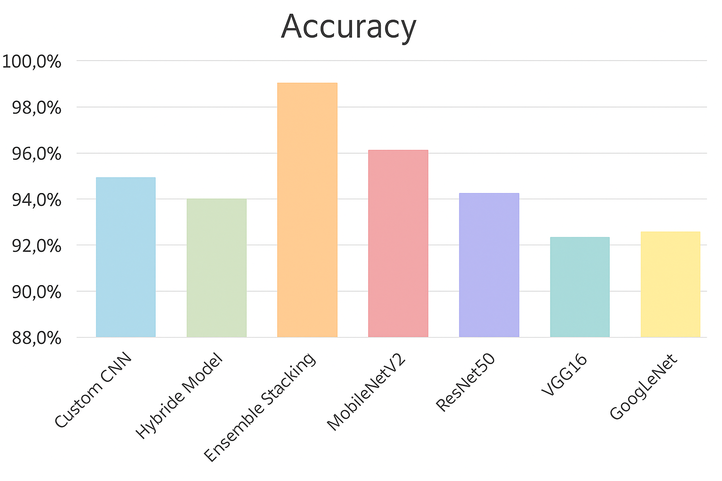
Performance Comparison
01
Highest Accuracy
Mercury is the closest planet to the Sun
02
Maturation
Jupiter is a gas giant and the biggest planet
03
Motor synergies
Neptune is very far away from the Sun

Slide 13
Finding best model
01
02
03
Highest Accuracy
Low Variance
Efficient Inference
outperforms all other models.
minimal gap between training, validation, and testing results → less overfitting.
ensemble stacking improves decision reliability without significantly increasing inference time.
04
05
Balanced Class Performance
Explainability
precision, recall, and F1-scores consistently strong across all 38 classes.
Grad-CAM visualizations confirm the model focuses correctly on diseased leaf regions.

Slide 14
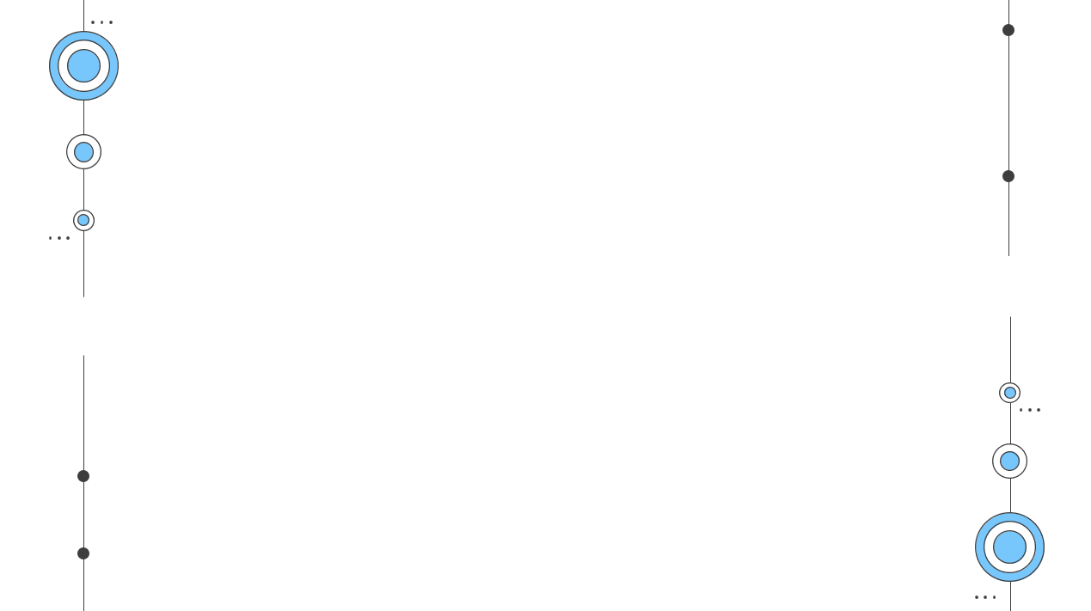
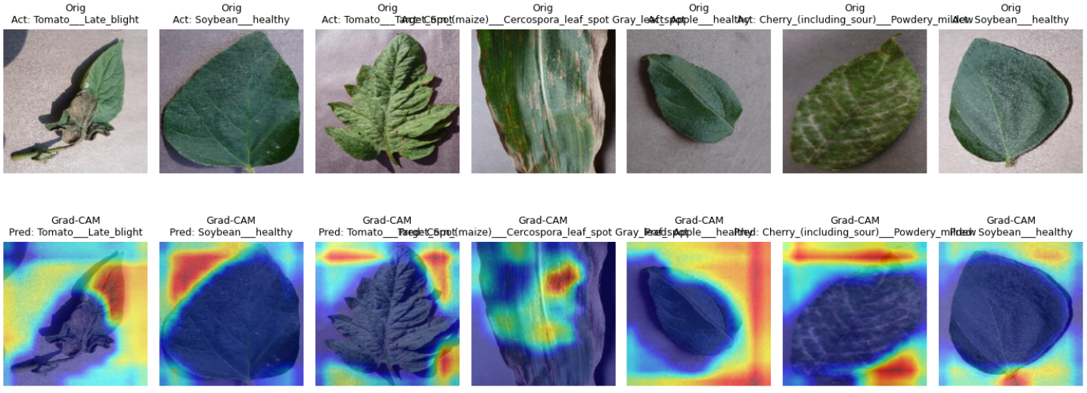
GradCam

Slide 15
Conclusion
01 | Custom CNN Ensemble Stacking achieved best accuracy.
02 | Pretrained models competitive but slightly weaker.
03 | Ensemble + attention mechanisms → strong robustness.
04 | Future work: real-time deployment on mobile devices.

Slide 16
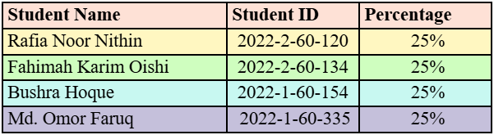
Contribution

Slide 17
Thank You
Please, keep this slide as attribution

